Slide 1

9-dars
Pip

Slide 2
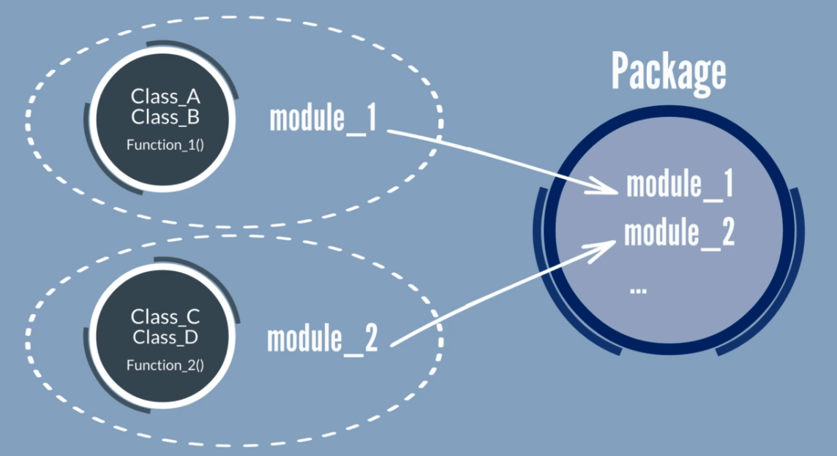
packagelar

Slide 3

package managerlar
PHP

Slide 4

package managerlar
JavaScript, CSS, HTML

Slide 5

package managerlar
Java

Slide 6

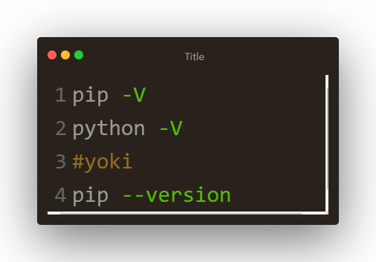
package managerlar
Python Package Index (PyPI)
pip
Pip Installs Packages
preferred installer program

Slide 7
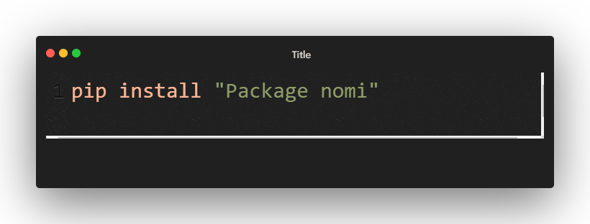
package install qilish
Terminalga yozish kerak
Endi python faylda packageni import qilib undan foydalanish mumkin

Slide 8
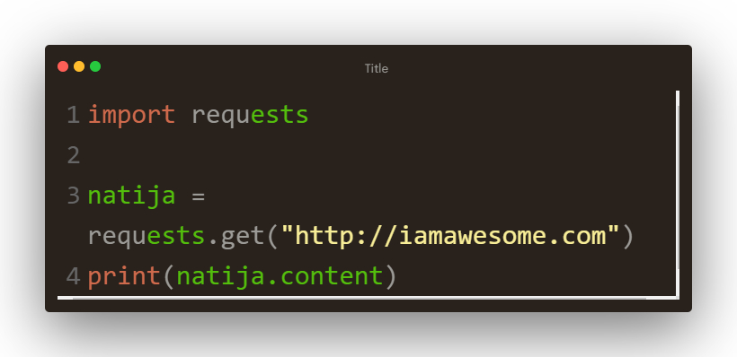
request
byte da natija jo’natadi

Slide 9
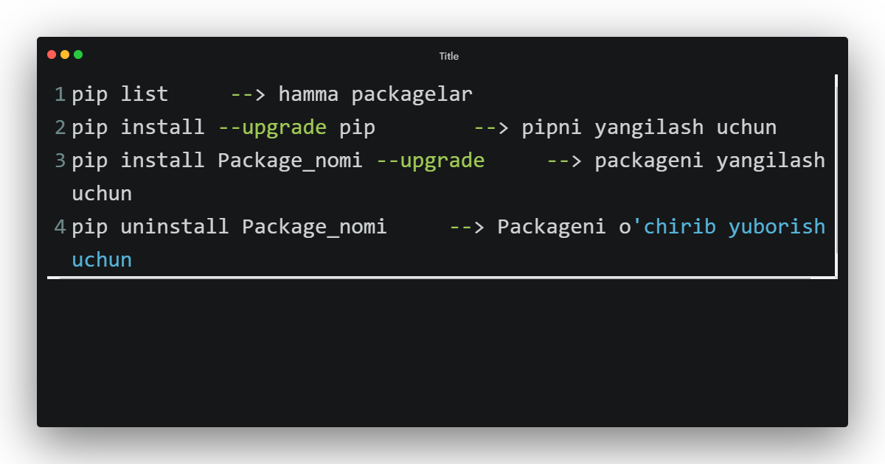
pip haqida

Slide 10
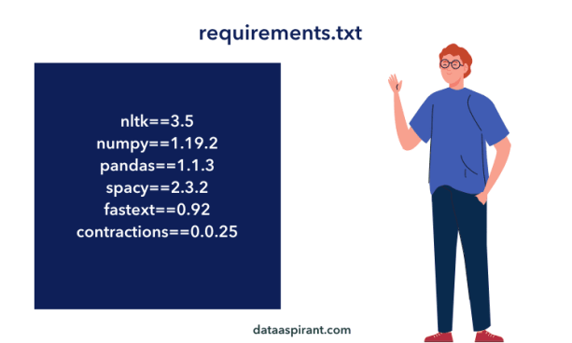
requirements.txt
Loyihamizdagi barcha packagelar nomini saqlaymiz
pip install –r requirements.txt

Slide 11
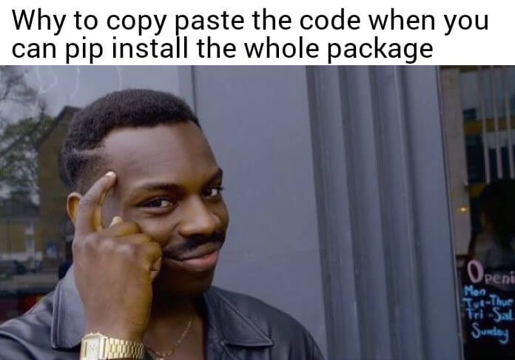
Packagelarni birma-bir emas, shunchaki requirements.txt ni install qilganingda

